Slide 1
ARL Notice List Application
Chelsea Rusch
Derek Klein
Pallavi Chamarthy

Slide 2
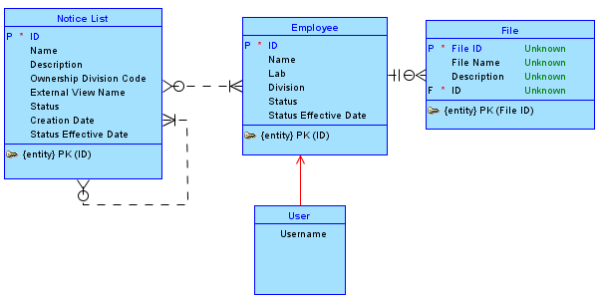
Conceptual Model

Slide 3
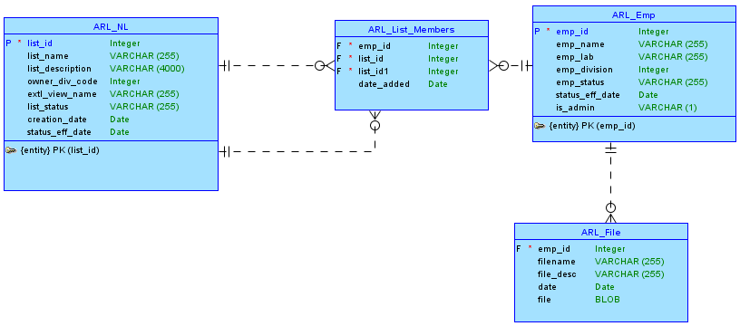
Logical Model

Slide 4
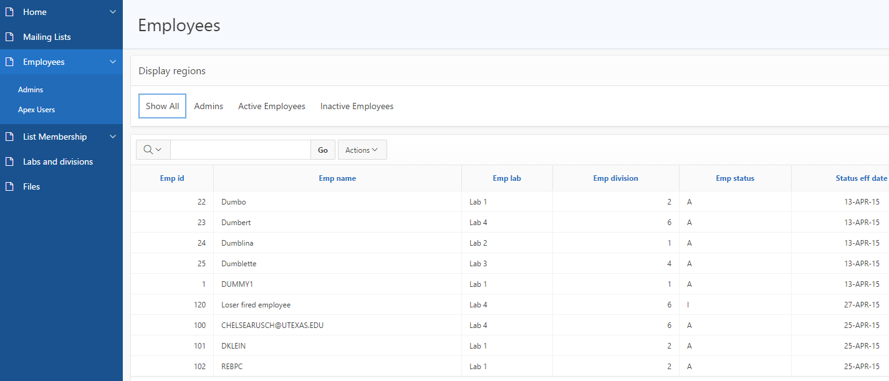

Slide 5
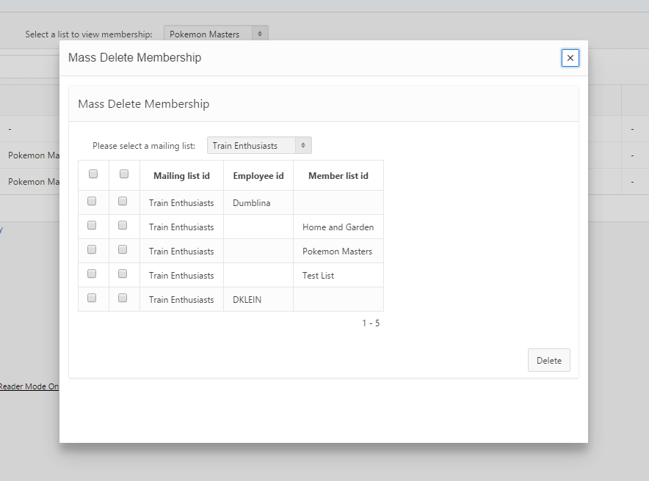

Slide 6
Implementation Details
Users/Admin privileges based on apex username
Emp_name must match username
Admin status not dependent on apex admin status

